Slide 1
Evolution of Europe’s Climate Monitoring Infrastructure
Group 2: Anthony Gumucio, Dustin Enriquez, Jennifer Mazas, Kathlyne Alilain, Nina Horesweather
CIS 4560-01: Intro to Big Data

Slide 2
Introduction
Objectives
Identify spatial distribution and coverage of weather stations
Analyze station elevation and operational timelines
Visualize insights using tempo-spatial maps

Slide 3
Platform Specs
Data Source
GitHub Link
Oracle Big Data Server
CPU Speed: 2.4 GHz
# of CPU cores: 4 cores per node
# of nodes: 5 nodes
Total Memory Size: 40 GB (8 GB per node x 5 nodes)
Dataset Link:
https://knmi-ecad-assets-prd.s3.amazonaws.com/ensembles/data/stations_info_tn_v30.0e.txt
Data Size:
4.6 GB
https://github.com/kalilai2/CIS-4560-01-Group-Project.git
Notes:
-memory size should be bigger

Slide 4
Relevance of Topic to Class
Using HIVE QL in Big Data to manipulate data in HDFS
Fundamental Shell and Hadoop commands
Creating Tempo-spatial Visualization
Connecting a node to a remote Hadoop cluster

Slide 5
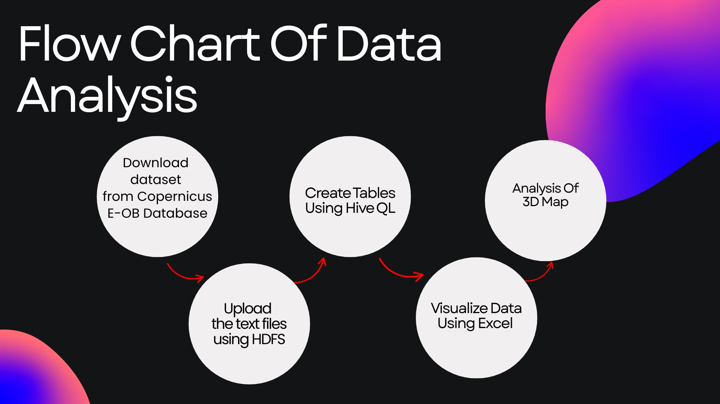

Slide 6
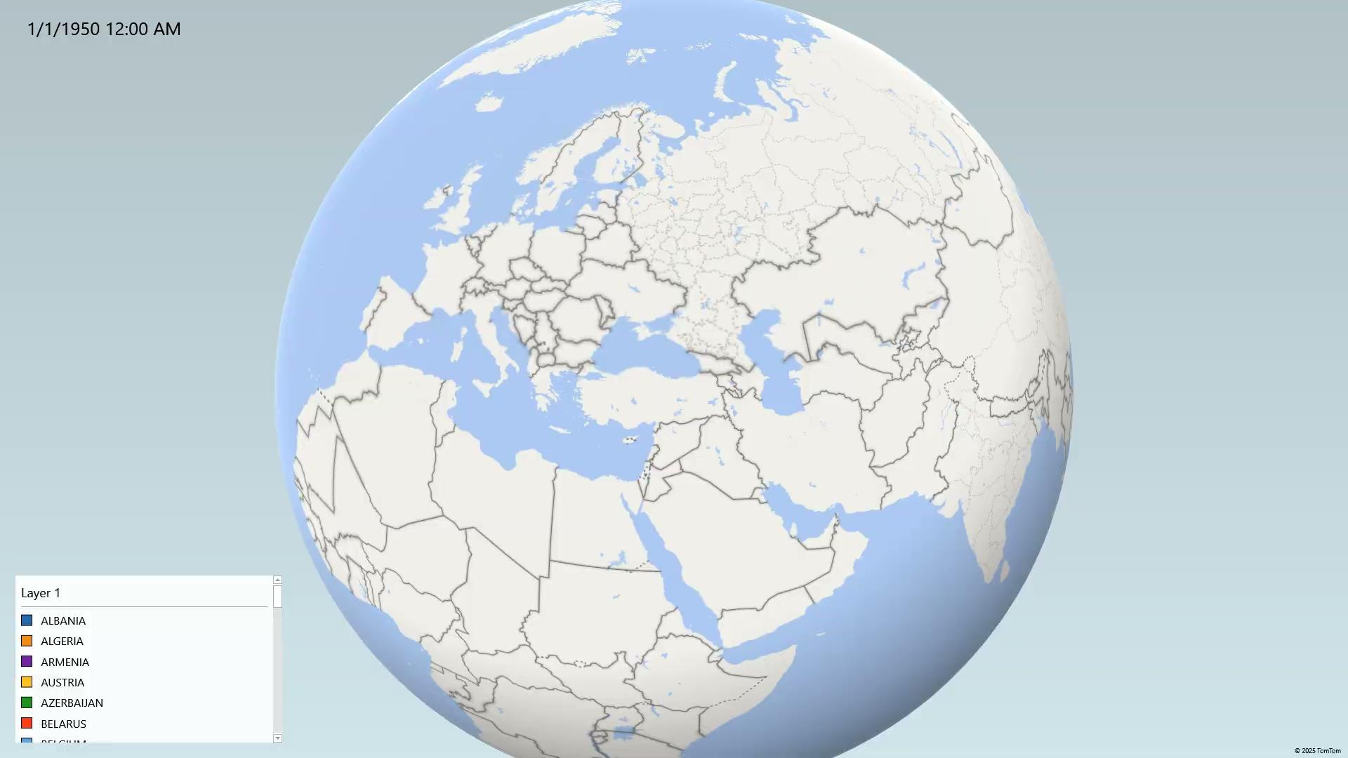

Slide 7
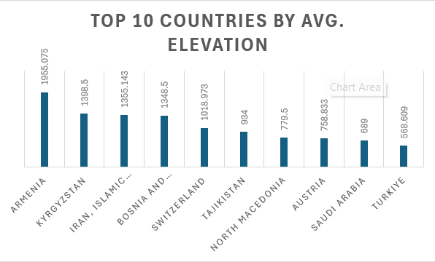
Top 10 Countries with the Highest Avg. Elevations of Weather Stations
Armenia and Kyrgyzstan ranked highest.
Located in mountainous regions.

Slide 8
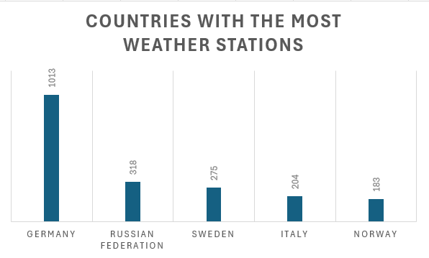
Countries with the Most Weather Stations
Germany had the highest number of stations = 1,013.
Where data collocation infrastructure is most developed.

Slide 9
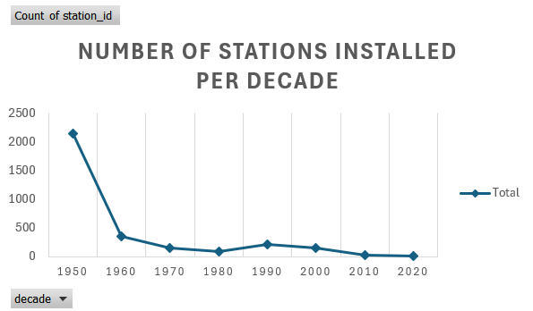
Number of Stations Installed Per Decade
1950s - Highest surge in installations after WWII
1960s - Installations declined significantly
Remained relatively low with sharp drops in the 2010s and 2020s.

Slide 10
Conclusion
Explored tempo-spatial patterns in Europe’s weather station metadata using Hadoop and Hive.
What we found:
Germany = Highest # of stations
Armenia = Highest average elevation
Station deployments expanded significantly after 1950.

Slide 11
Conclusion
Why it Matters:
Establish a foundation for future temperature trend studies.
Importance of climate data infrastructure.
Next Steps:
Integrating actual max temperature data to assess regional warming trends.

Slide 12
THANK YOU
Any questions?

